Slide 1
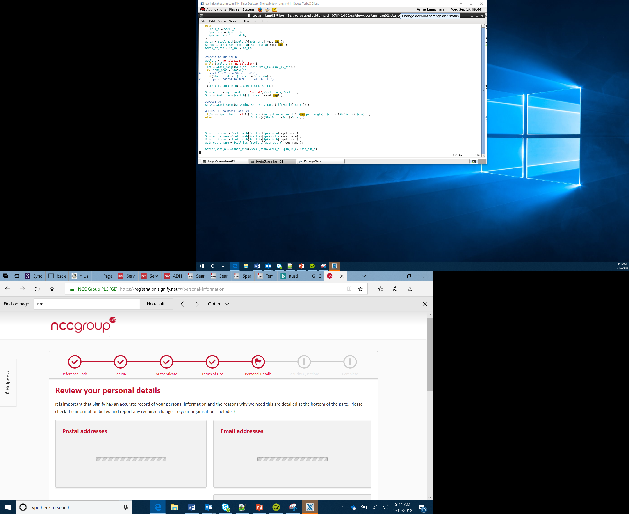

Setting up a Speaker, Module and Music
Lesson 10

Slide 2
What the Lesson Will Cover
Know how to wire up a speaker with the micro:bit
Know what a module is and import one into a program
How to use Python to program a musical composition

Slide 3
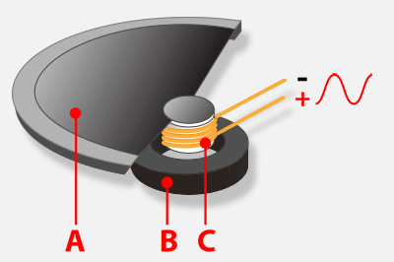
How a Speaker Works
A speaker produces sound by moving the air around it to create a sound
The magnet B is controlled by the current C which is sent along the positive wire
The magnet can either push or pull the cone A, which moves the air around it
Your ears hear these changes and interpret them as sounds, noise, talking or music
Notes:
Show a speaker if you have access to one, you could play some music so the Learners can see the cone moving.

Slide 4
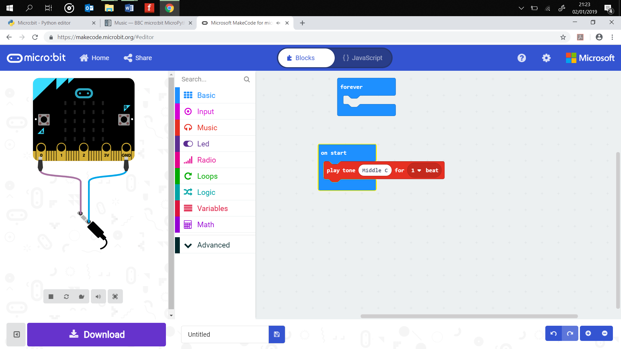
Speaker Set Up
The micro:bit can produce music
It needs a speaker or headphones
Use the crocodile clips to wire up as shown in the diagram
The wire on the far left sends the signals to the jack on your speaker cable and controls the cone
Notes:
Copy over the NYAN music code to a teacher micro:bit and start it playing as the Learners enter the room

Slide 5
Modules
This program uses a module – libraries of code that offer additional functions to the Python programming language
Imagine a car, you have a basic model and then you can add in extra modules such as Sat Nav, sound system, AC, heated seats
To use a module we have to import it using the command import followed by the name of the module
from microbit import *
import music
music.play(music.NYAN)
Notes:
Ask Learners if they can name any other modules, import time, import random etc.
Learners complete first activity and set up music playing.

Slide 6
Lists
The program for a musical composition uses a list
import music
tune = ["C4:4", "D4:4", ADD YOUR NOTES]
music.play(tune)
A list is like a shopping list – it contains all the items that you need. To create a list you need to name the list and then add the items.
shopping = [“apples”, “bread”, “cake”]
Note that each item is between “ ” and the whole list sits in square brackets [ ]
Notes:
Explain what a list is, how to create one - reference back to activity sheet

Slide 7
Creating a soundtrack
Think of a superhero or a film and then image the type of music that would be used
If you are not sure then you can always think of your favourite theme tune or song
Notes:
Learners complete the second part of the activity sheet and compose a theme tune.
Learners can perform and judge the compositions as part of the lesson.

